Slide 1
IBM Call for code Challenge
RESPONSIBLE PRODUCTION AND GREEN CONSUMPTION
CODE CREW

Slide 2
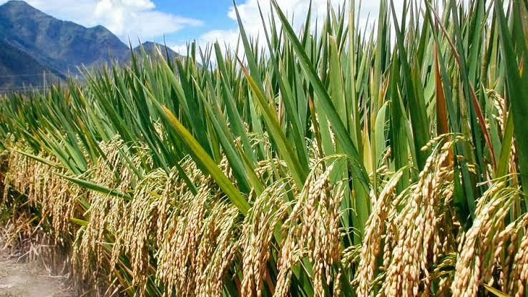
FARMER PICKUP:
Responsible production requires manufacturing goods and services in an ethical and sustainable way.
This minimizes waste and pollution and supports long-term sustainability of surrounding communities and their natural environments.
Oftentimes, the initial investment towards more sustainable processes will result in a greater return on investment in the long run.
Additionally, more consumers are preferring organizations with demonstrated environmental and ethical practices.

Slide 3
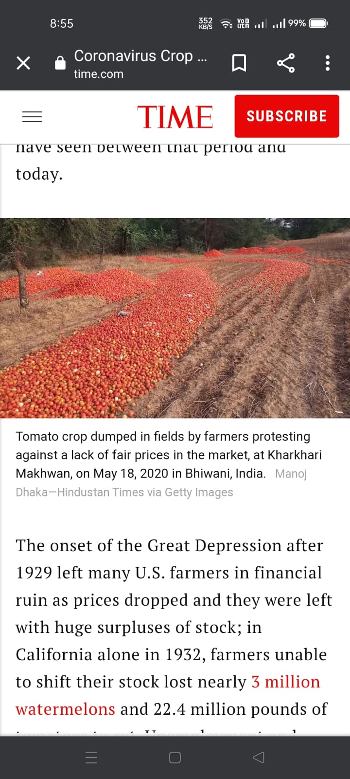
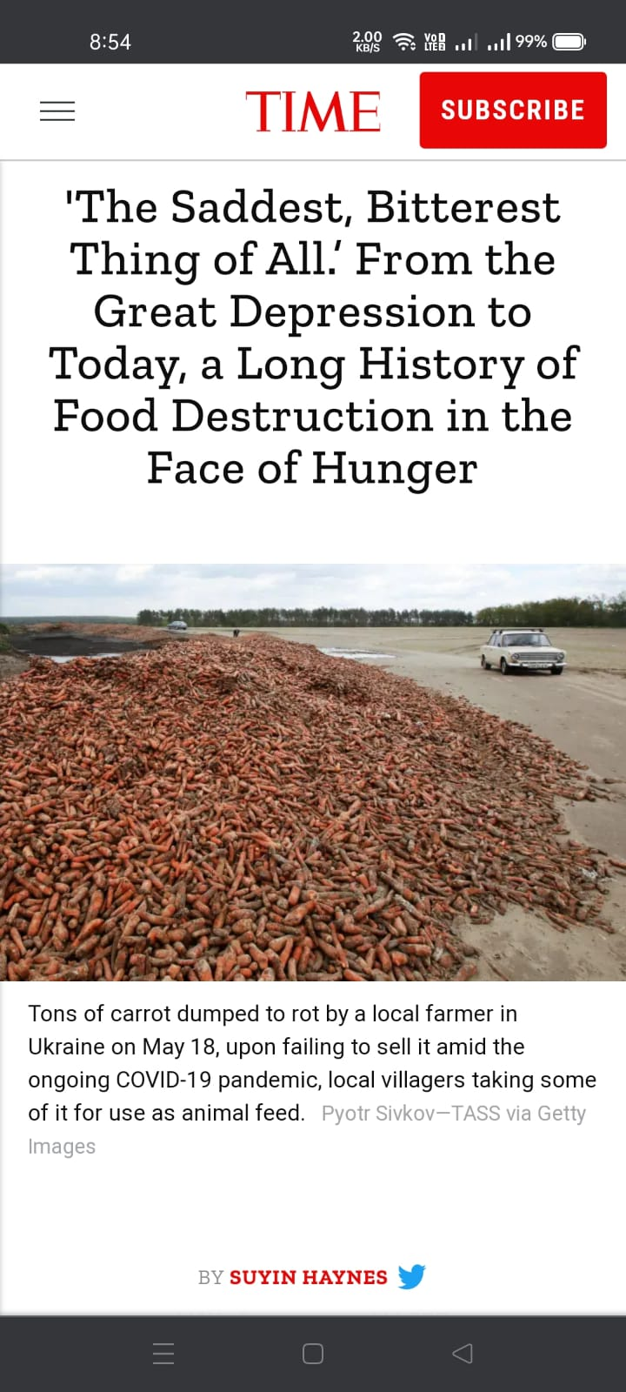
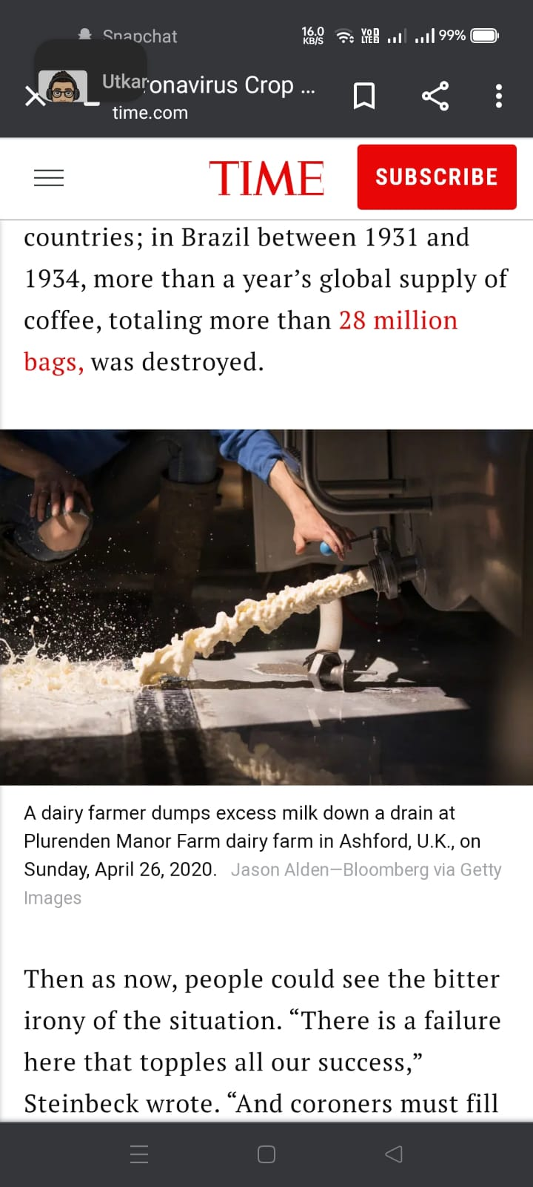
PROBLEM:
Inefficient Supply Chain.
Expensive product
product waste due to lack of consumer at time.
Wastage of crops due to natural calamities, damaged roads etc.
It takes lots of time to deliver in market.
Farmer doesn’t get appropriate amount for the products.
Won’t be able to sell products in cities market due to climate change reasons.

Slide 4
SOLUTION:
The idea is that the farmers sell their product on a technical platform.
We are getting forward to the application in which the farmers connect to buyer for selling process.
This will help farmers to sell there products which are not sold in market due to unavailability of transport, heavy rain, flood etc.
This will establish the direct link between consumer and producers.

Slide 5
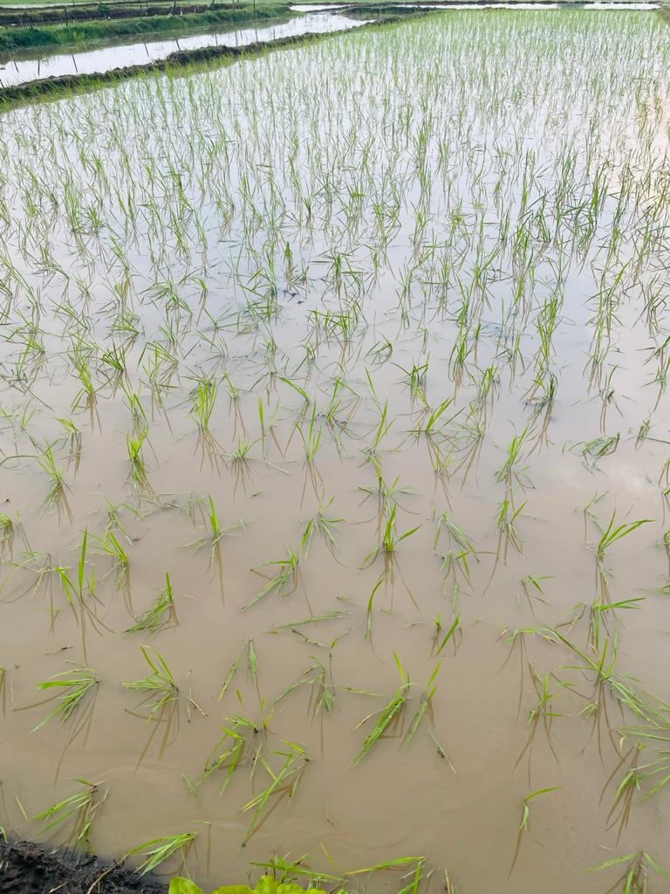
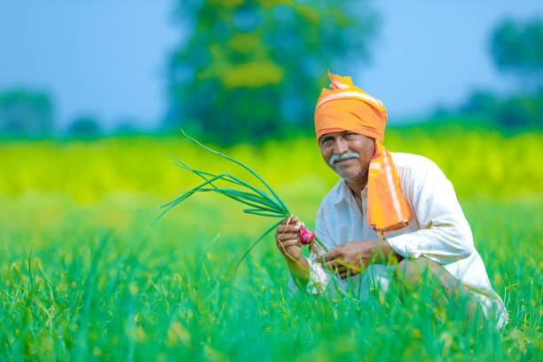
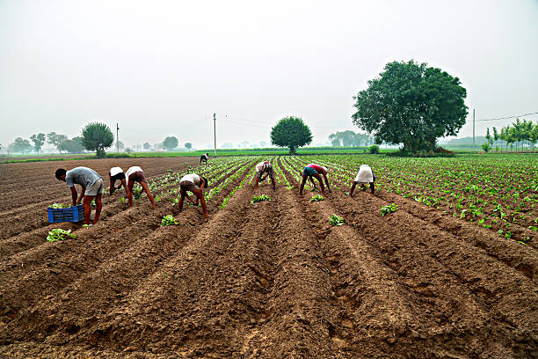
BENEFITS OF FARMER:
Less wastage of crop.
More profit.
Reduction of storage costs.
Direct contact and improve the communities
they serve.
Time saving.
Exploration of crops.
Learning of new technology.
Farmer creates opportunities to lift people out
of poverty in developing nations.

Slide 6
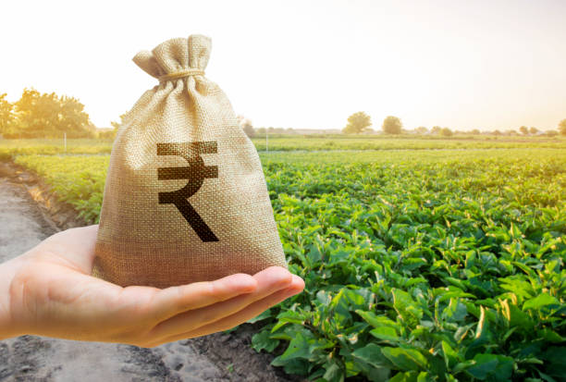
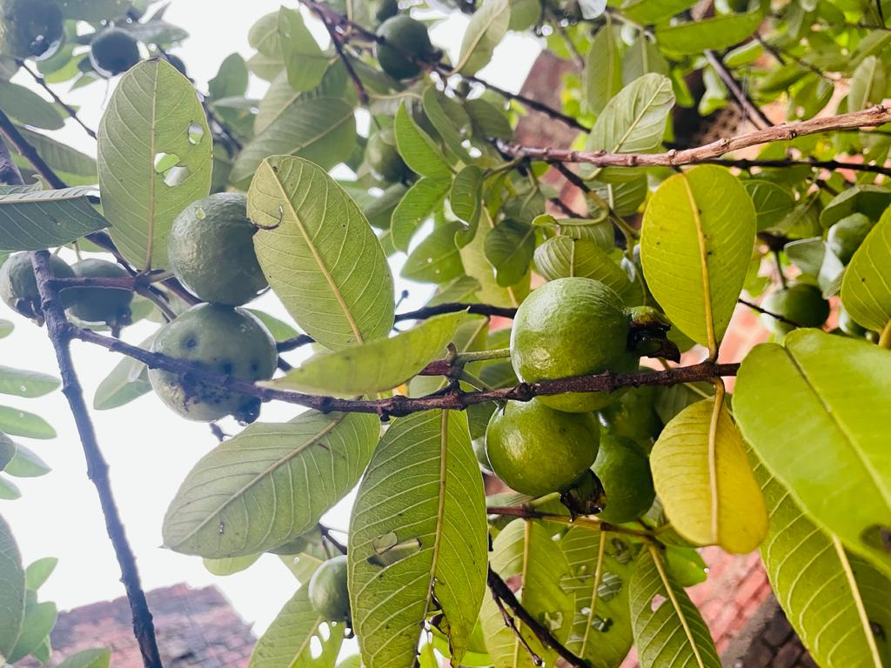
BENEFITS OF CONSUMER:
Food will be available at low cost.
Goods will be available in bulk.
Different varieties can be purchased.
Time saving.
Instance Delivery.
Availability of product in all over areas.
Consumer gets healthy and safe food.
Organic food builds strong future generation.

Slide 7
HOW IT DIFFERENT FROM OTHERS:
Farmer pickup app offers you the most convenient way to shop and sell vegetables , fruits as well as grains.
Unlike other app, this app will work like a medium between farmers and customers.
It can be done on large scale.
It will provide natural products (Organic)to buyer.
It will also provide natural processed products like tomato sauce, etc.
Buyer can visit farms if they want to see the process of selling or product making.
Funds will be generated so that farmers can use it in emergency.

Slide 8
STEPS:
Built an application
Launch that application on mobile store
Register to the app
Connect to the consumer
Selection of products
Deliver the product

Slide 9

App demo:
Work flow video:

Slide 10
RoadMap
Phase 1-4
Web Development
Getting started on IBM cloud
Phase 5
WhatsApp chatbot
Phase 6
MOBILE APPLICATION

Slide 11
Phase 1to4 - Development
week1
28 June-2July
week2
5-9 July
week4
17-23 july
week3
12-16 July
Word Documentation
Development
Home, login, Index, (Choose role – Framer/Buyer),
Idea Finalization
Deploy app on IBM Cloud.
Exploring on IBM cloud (Language, server, location, source code.)
Exploring about idea.
Developing video

Slide 12
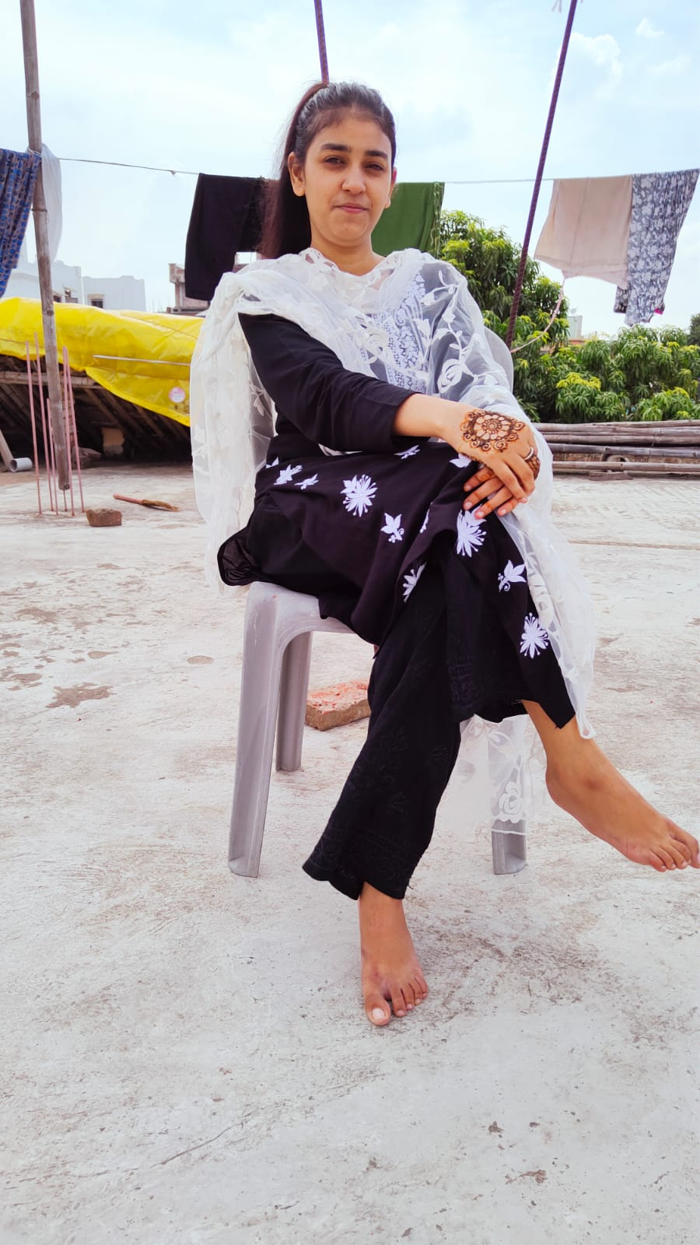
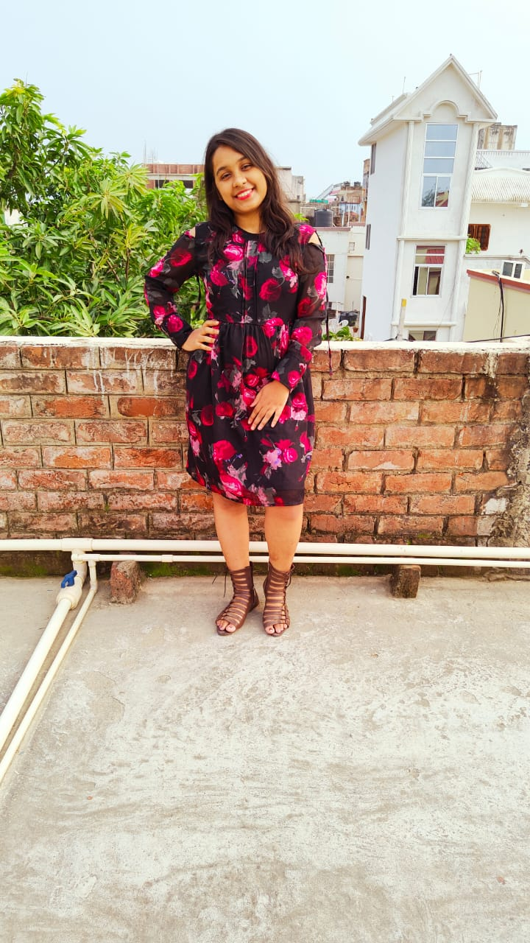
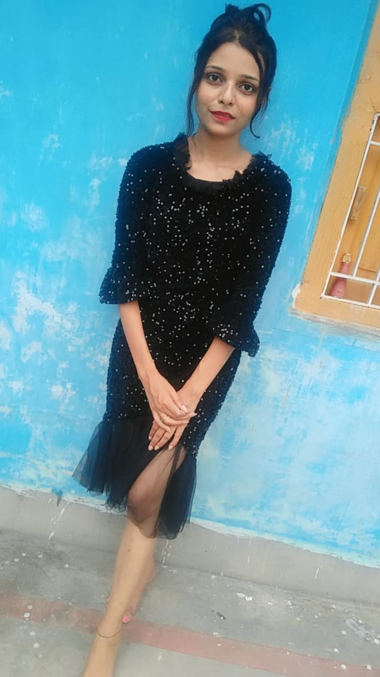
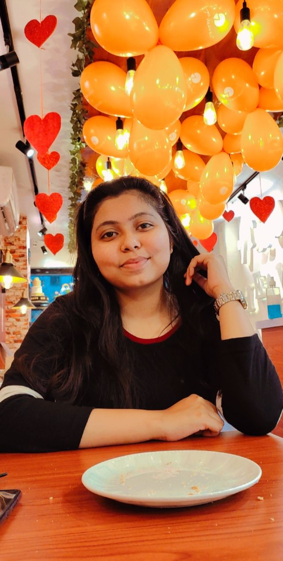
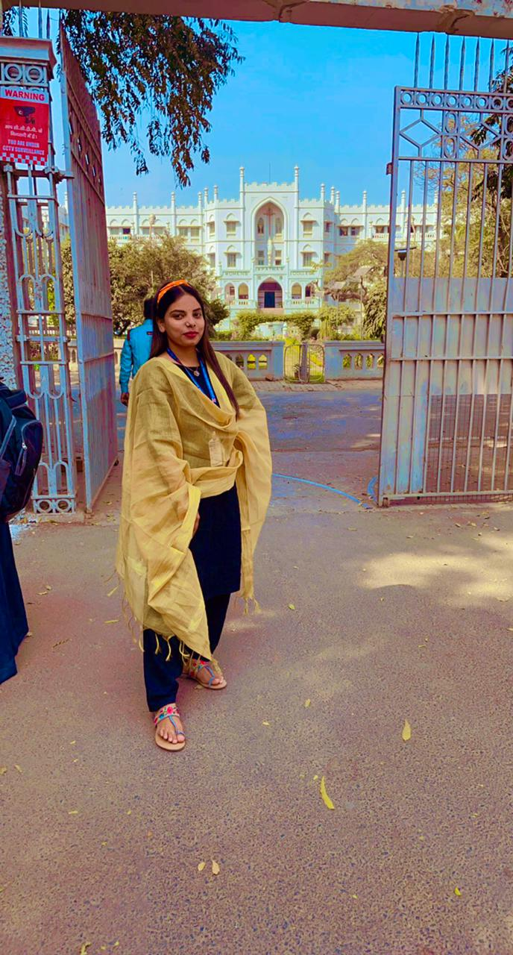
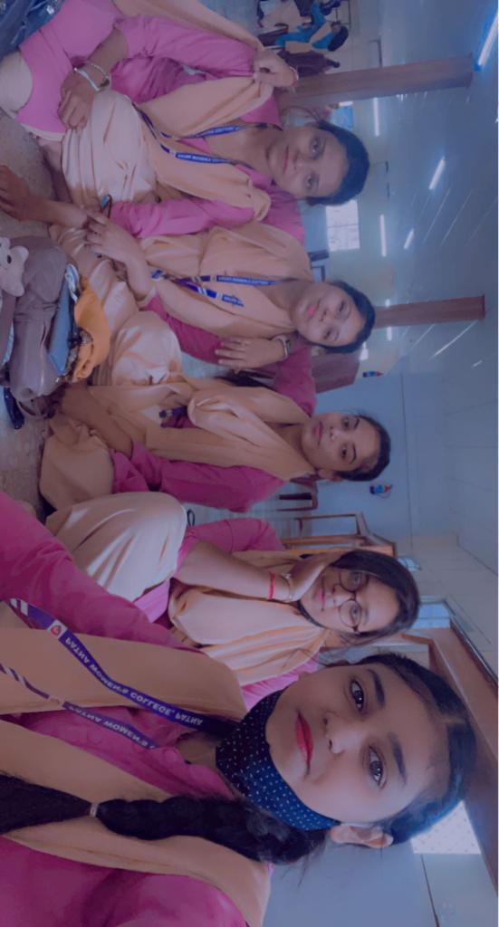
CODE CREW
Group Leader
Mantasha Fatima
Work – Managing whole thing.
Group Member
Kaushiki Kumari
Work – Programming
Group Member
Riya Sinha
Work – Roadmap &
Video editing.
Group Member
Megha
Work- Documentation & ppt
Group Member
Sanobar Parveen
Work –Video & photography editing.

Slide 13
Our Mentor
Swanand Gadre
Thank you for being an amazing mentor. You’re great in every way! You inspire us to work hard and dream big. We are truly thankful to have a genius mentor like you. Thank you Sir! It’s honorable for us to be under your supervision. I learned a lot from you.

